Slide 1
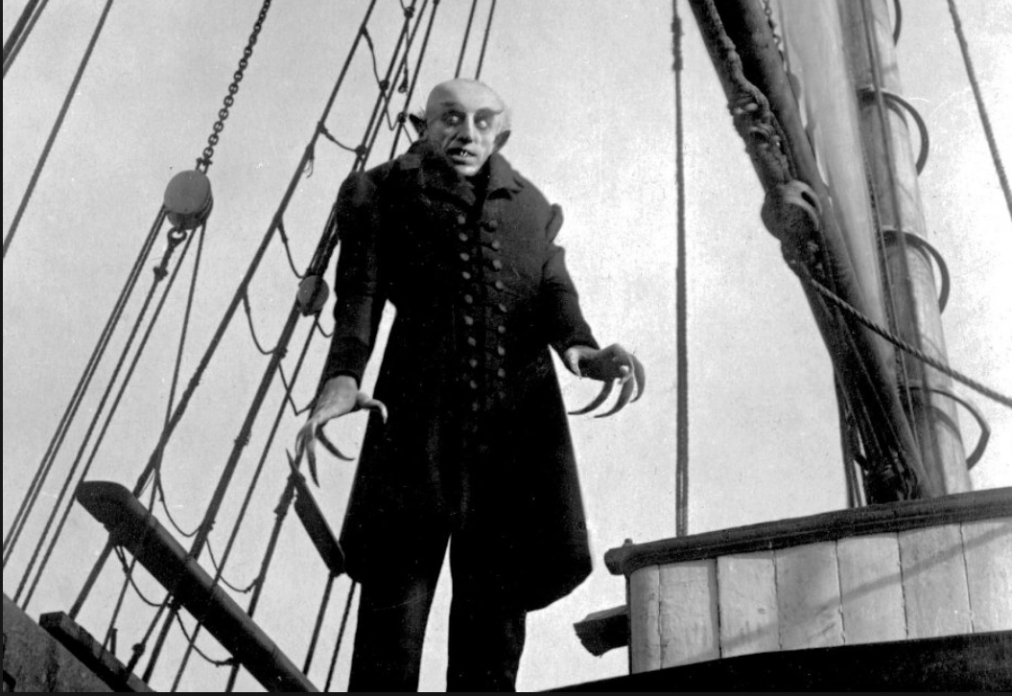
Choosing a Topic
Bos
ENGL1102

Slide 2
Importance
The topic you choose will be the focus for your research and writing in this course.
The prospectus asks you to provide an overview of the topic, think of research questions, and find preliminary sources.
Next, you will develop a literature review of sources you plan to employ in your research.
The final component is a paper in which you’ll enter the scholarly conversation on your topic by providing your own interpretation or insight.

Slide 3
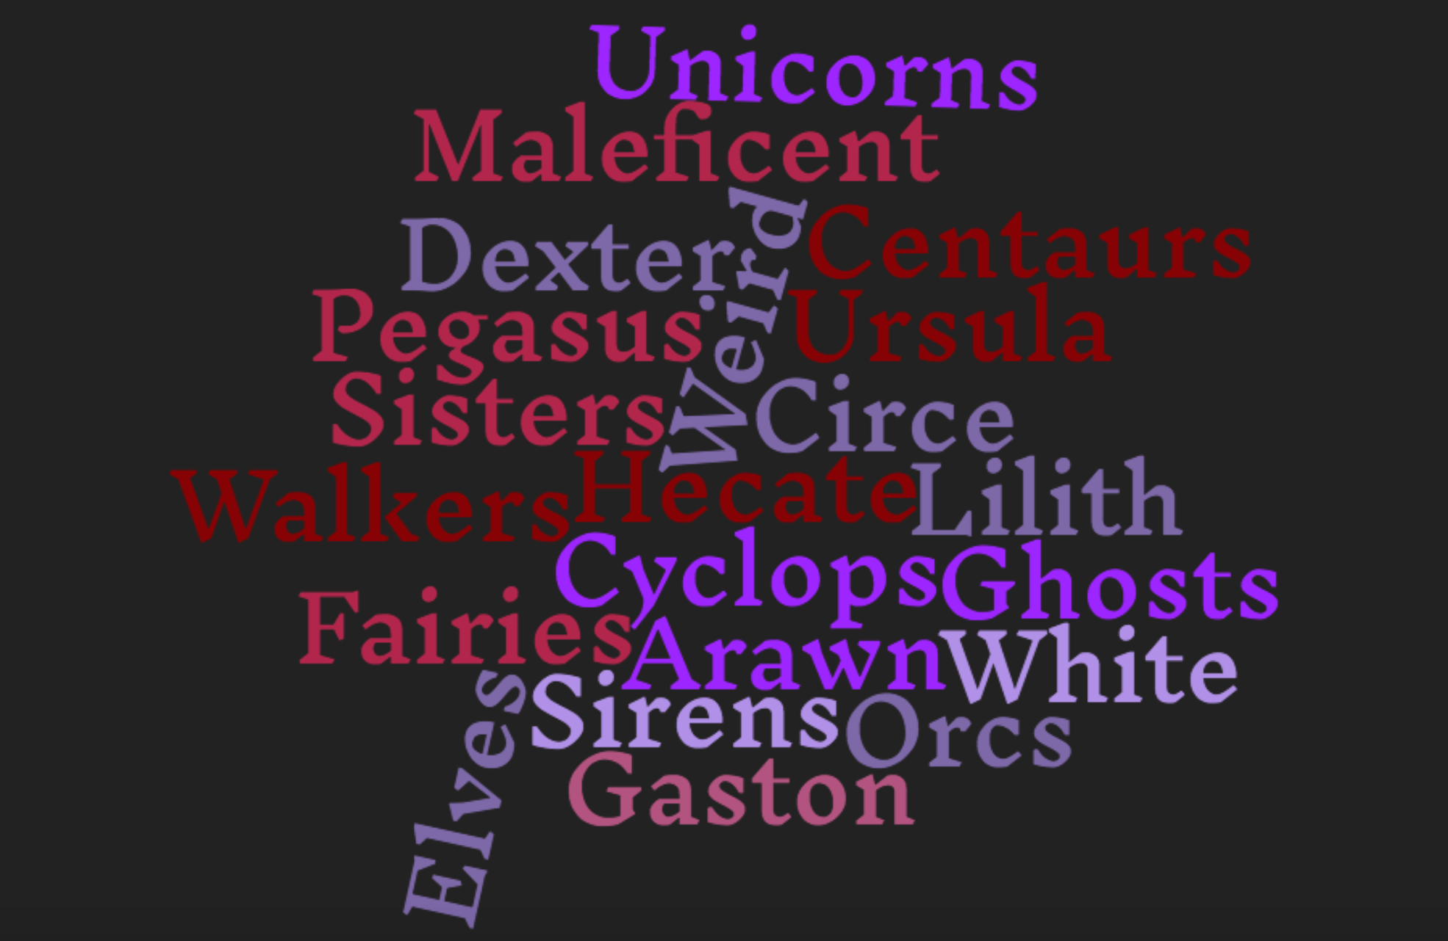
Theme
Your topic should relate to our course theme of monsters; this includes fantastic beasts, mythological creatures, etc.
Within this parameter, you can take a variety of approaches, but remember that you will need to develop an original argument (thesis) about your topic.

Slide 4
Why can’t I write about whatever I want?
I’ve found that it works best to teach research strategies when we’re all doing the same kind of research and examining similar topics.
To write effectively about monsters, you can use a range of sources. Scholarly work provides a foundation and ideological orientation, while reading news articles and visiting online forums can add nuance and depth.
This kind of topic allows you to engage with various types of sources and learn how to ask — and answer — sometimes difficult questions about credibility.

Slide 5
Why can’t I write about whatever I want?
Because there are so many monsters and fantastic creatures, most students can find (or define) one that appeals to them. Being engaged in a topic usually leads to stronger work!
Monsters connect with some of my areas of interest and expertise, so I can often provide more specific guidance and help than I could with other topics.
In some cases, I can even point you to specific sources.

Slide 6
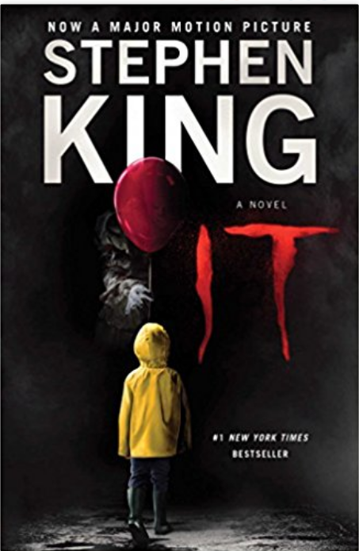
Choose a topic…
That you find engaging
That’s appropriate for this assignment and your audience
That allows for solid, productive research questions
About which you can find appropriate sources

Slide 7
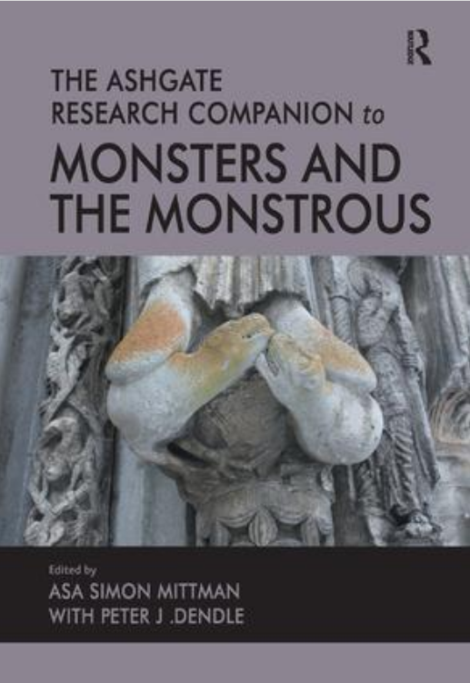
Tips for selecting your topic

Slide 8
Various approaches
Compare/contrast a book and a film
Examine the cultural significance of a specific monster or creature
Look at how a monster has changed in different contexts
Examine the role of monsters or creatures in a video game

Slide 9
Questions to consider
Is your topic specific enough to allow meaningful research?
Can you find an appropriate number of sources?
Are there gaps in the research, or has this topic been thoroughly addressed?

Slide 10
Questions to consider
Can you think of an original perspective or approach to the topic?
Do you have strong feelings that might interfere with your objectivity as a researcher?
Do you have a thorough knowledge of the topic, or are there questions you can still explore?

