Slide 1
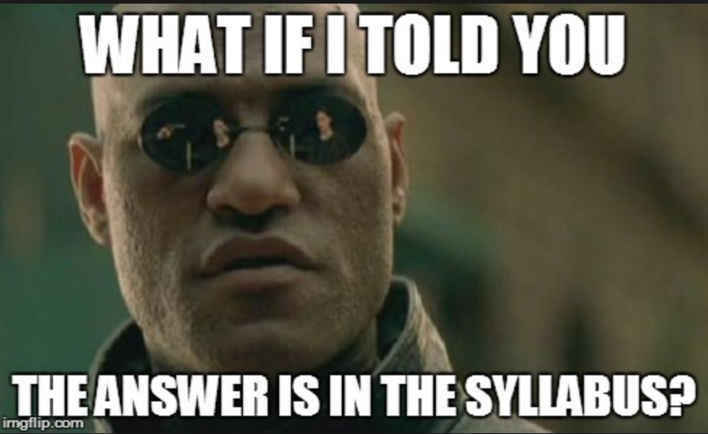
Syllabus Design
14 November 2017

Slide 2
Pre-activities
Think of an introductory-level course in your field that you might teach or might like to teach
What would you look for in a syllabus?

Slide 3

Overview of Research

Slide 4
Why do syllabi matter?
Establishes priorities and expectations (Keller et al., 2014; Sulik & Keys, 2013)
Sets the tone for the class (Sulik & Keys, 2013)
Answers students’ question of “What’s in it for me?” (Canada 2013)

Slide 5
Tone matters
Plain and direct language
Friendliness
Humility
  (Canada, 2013)
A syllabus that seems warm, friendly, and welcoming leads to similar perceptions of the instructor (Sulik & Keys, 2013)

Slide 6
What do students like?
Information about course materials
Information about their grades, especially
  Extra credit
  Types of quizzes and exams
  Out-of-class activities (Keller et al., 2014)
Assignment information and rubrics
Due dates
Graphic syllabi (concept maps)—with some explanation of what a concept map is (Sauer & Calimaris, 2015)

Slide 7
Length
Students prefer medium (9-page) and long (15-page) syllabi to shorter versions (Harrington and Gabert-Quillen, 2015)
  Greater overall impression of course and professor
  Expectation that the instructor would be more caring and helpful
  Students said they were more willing to seek help from the instructor and were more motivated to take the course
These results applied to students with more than 24 credit hours. Students with under 24 credit hours reported no significant changes in perception based on syllabus length.

Slide 8
Benefits to Faculty
Enthusiasm and excitement about syllabus design and course
Positive first impressions can lead to better evaluations
Students who perceive the professor as friendly and helpful are more likely to ask questions and seek help
Can immediately create an open dialogue between instructor and students
Ideally, a user-friendly thesis will lead to more usage amongst students and fewer e-mails with questions you already answered in the syllabus.

Slide 9
Sample Syllabi
History 1000
English 1101
Focus on the course introduction and 1-2 other sections.
  What impression of the course do you have after looking at the syllabus?
  What impression of the instructor do you have after looking at the syllabus?

Slide 10
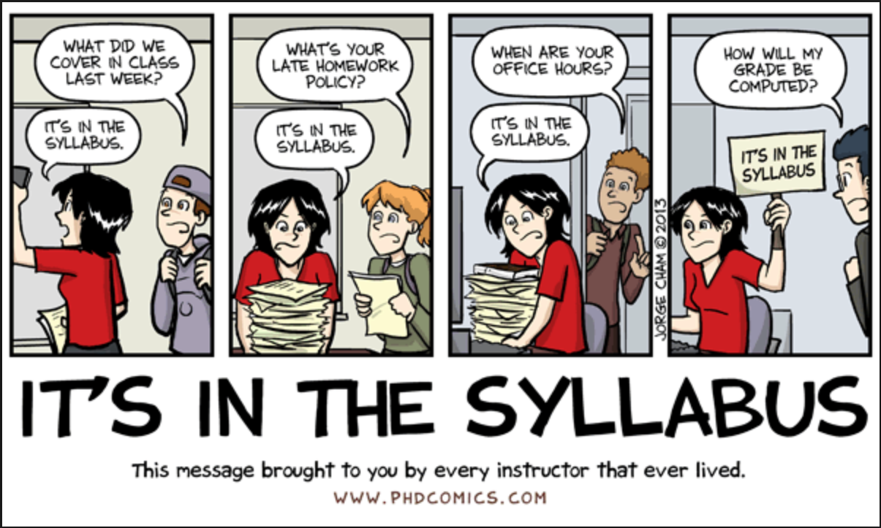
Debrief

Slide 11
Activity
Write a brief (2-3 sentence) course introduction to your syllabus.
Outline the sections in the rest of your syllabus.
  What content would you include, and why?
  What content would you choose not to include, and why?

Slide 12
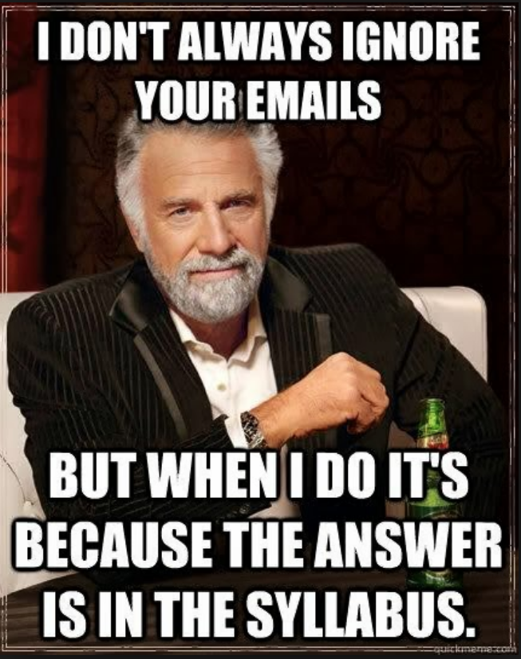
Syllabus Rubric

Slide 13
Sources
Canada, M. (2013). The syllabus: A place to engage students’ egos. New Directions for Teaching and Learning 135, p. 37-42. doi 10.1002/tl.20062
Harrington, C.M. & Gabert-Quillen, C.A. (2015). Syllabus length and use of images: An empirical investigation of student perceptions. Scholarship of Teaching and Learning in Psychology 1:3, p. 225-243.
Keller, C.E., Marcis, J.G., & Deck, A.B. (2014). A national survey on the perceived importance of syllabus components: Differences and agreements between students and instructors in the principles of accounting course. Academy of Educational Leadership Journal, 18:3, p. 23-34.
Sauer, K.M., & Calimeris, L. (2015). The syllabus evolved: Extended graphic syllabi for economics courses. Journal of Economics and Economic Education Research 16:1, p. 135-48.
Sulik, G., & Keys, J. (2013). “Many students really do not yet know how to behave!”: The syllabus as a tool for socialization. Teaching Sociology 42:2, p. 151-160.

